Slide 1

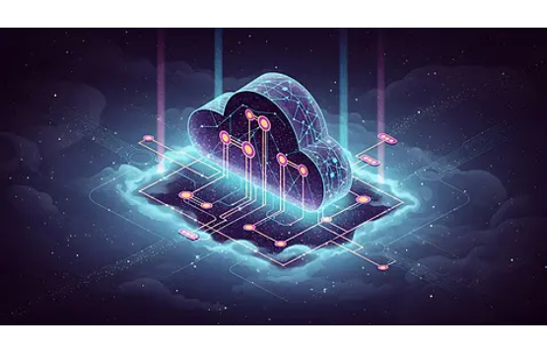
THE FUTURE
PROTOCOL
Decentralized Solutions

Slide 2

THE PROBLEM
CENTRALIZED BOTTLENECKS

Slide 3




SYSTEMIC FAILURES
DATA SILOS
SECURITY RISKS
Legacy systems trap valuable data in isolated environments, preventing interoperability and slowing down innovation speed by 40%.
Centralized servers create single points of failure. In 2023 alone, centralized breaches cost the industry over $4 Billion.

Slide 4

THE DECENTRALIZED
SOLUTION
A trustless, immutable infrastructure layer.
Distributed Nodes: Zero downtime architecture driven by a global community.
End-to-End Encryption: Military-grade security protocols ensuring data sovereignty.
Scalable Consensus: Processing 50,000+ transactions per second.

Slide 5






CORE ARCHITECTURE
IMMUTABLE LEDGER
SMART CONTRACTS
P2P NETWORK
Direct peer-to-peer data transfer reducing latency and costs.
Tamper-proof history of all transactions ensures absolute transparency.
Self-executing automated workflows that remove intermediaries.

Slide 6
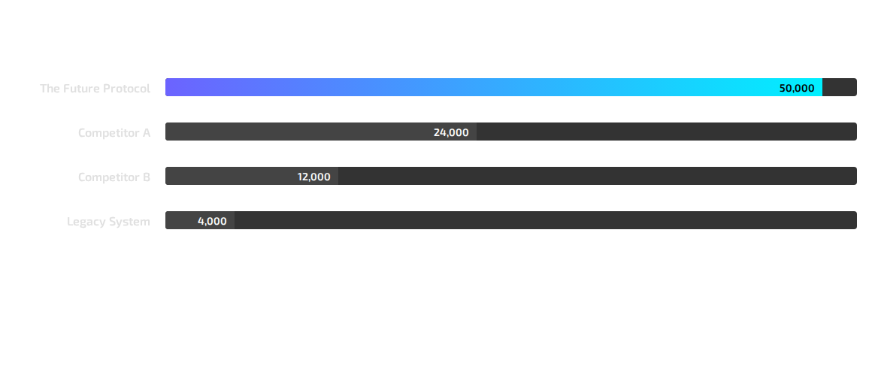
TRANSACTION SPEED (TPS)
Outperforming legacy systems by over 10x.

Slide 7
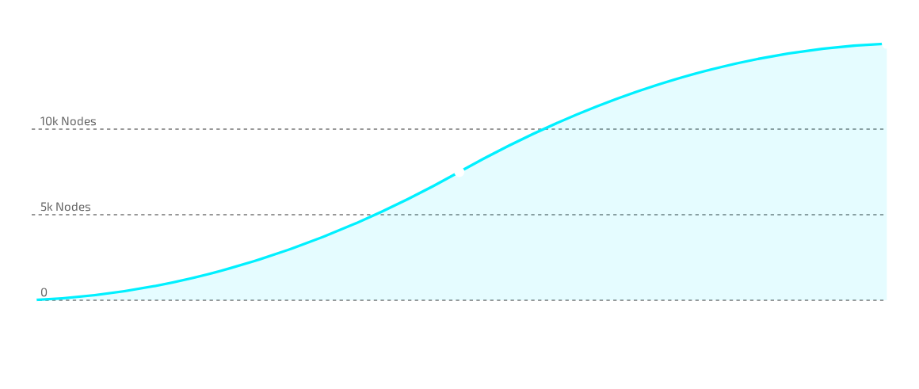
NETWORK GROWTH
Exponential node adoption in last 12 months.

Slide 8



TRACTION
1M+
50k
$500M
TRANSACTIONS
ACTIVE NODES
TOTAL VALUE LOCKED

Slide 9





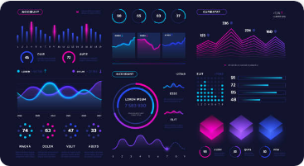
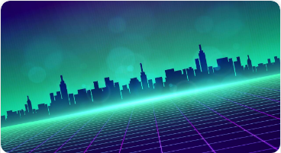


ECOSYSTEM USE CASES
DEFI
SMART CITIES
IDENTITY
Decentralized Exchanges & Lending
IoT Data Verification
Self-Sovereign ID Management

Slide 10



2025 ROADMAP
Q1: LAUNCH
Q2: SCALE
Q3: EXPAND
Q4: GOVERN
Mainnet Beta &
Token Generation Event
Exchange Listing &
Developer SDK V1
Cross-chain Bridges &
Mobile Wallet
DAO Transition &
Community Grants

Slide 11

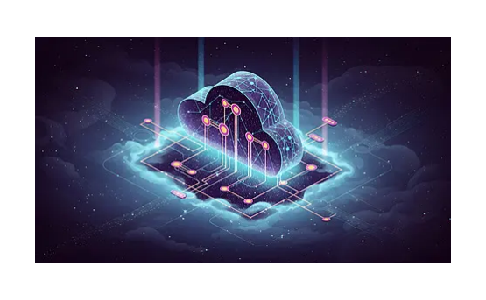
TOKENOMICS
Total Supply: 1,000,000,000 Tokens
Utility: Gas fees, Staking, Governance
Deflationary: 2% burn on every transaction
Distribution: 40% Community, 20% Dev, 20% Investors, 20% Reserve

Slide 12



JOIN THE FUTURE
contact@futureprotocol.io

Slide 13





IMAGE SOURCES
https://png.pngtree.com/thumb_back/fh260/background/20251030/pngtree-abstract-digital-cloud-computing-network-with-circuitry-and-data-streams-image_20135758.webp
Source: pngtree.com
https://static.vecteezy.com/system/resources/previews/055/845/010/non_2x/neon-blue-blockchain-cube-network-symbolizing-digital-security-decentralization-and-futuristic-technology-vector.jpg
Source: www.vecteezy.com
https://media.istockphoto.com/id/1353426419/vector/futuristic-ui-dashboard-technology-infographic-data-interface-charts-statistic-diagrams.jpg?s=612x612&w=0&k=20&c=0tN9HJPF9qbrFzOOh9hoX2Fy9MVO7ErGvhjfhLxOLk0=
Source: www.istockphoto.com
https://static.vecteezy.com/system/resources/thumbnails/022/168/865/small_2x/digital-technology-metaverse-neon-blue-green-background-cyber-information-abstract-speed-connect-communication-retro-city-future-meta-tech-internet-network-connection-ai-big-data-illustration-3d-vector.jpg
Source: www.vecteezy.com
https://static.vecteezy.com/system/resources/previews/051/808/532/non_2x/futuristic-glowing-fingerprint-with-plexus-lines-and-glitter-particles-biometric-in-the-neon-light-style-3d-abstract-copy-space-in-the-night-view-digital-technology-background-vector.jpg
Source: www.vecteezy.com

